Slide 1
ASDs
Task 5

Slide 2
Product description
An application continuity service dynamically backs up and restores the state of applications running within the framework on K8s. The service shall use the DSL of the framework to determine the relevant application state and its backup policies. Developers of an application should be able to backup and restore a specific version from images and relevant state from the service. The application state shall be stored externally on the given S3-compatible object storage.
Team: Gorelyi Mikhail, Lukashin Daniil, Derezovskiy Ilya, Sigal Lev
Repo: https://github.com/gorelyi-code/advanced_software_designers
Report: a link to this slides within project repo/doc storage

Slide 3
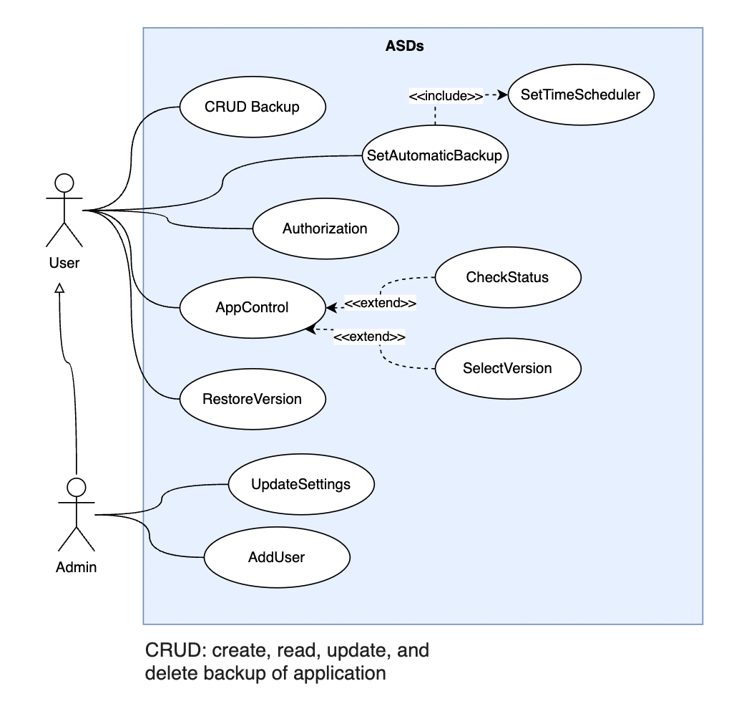
Use case diagram

Slide 4
Class candidates (problem domain)
Candidate | Criteria | Stored information | Operations
Kubernetes | T
Kubernetes manager | OUT |  | ApplicationControl, SetKubernetesSetting
Application manager | OUT |  | CreateVersion, RestoreVersion, AddApplication, SetAutoBackup
Account | SO | Accesses | Authorize, GetAccess
Application | SIAOUT | Data, Status | Activate, Deactivate
Version | SUT | Application
Storage | SOUT | Version | GetLatest, GetById, GetVersions
Notes:
Quick notation
– S : stores information
– I : has interface to to change stored information;
– A : information has structure;
– O : interface has several operations
– U : attributes and operations are shared by all instances (universal);
– T : essential for complete/well-formed model

Slide 5
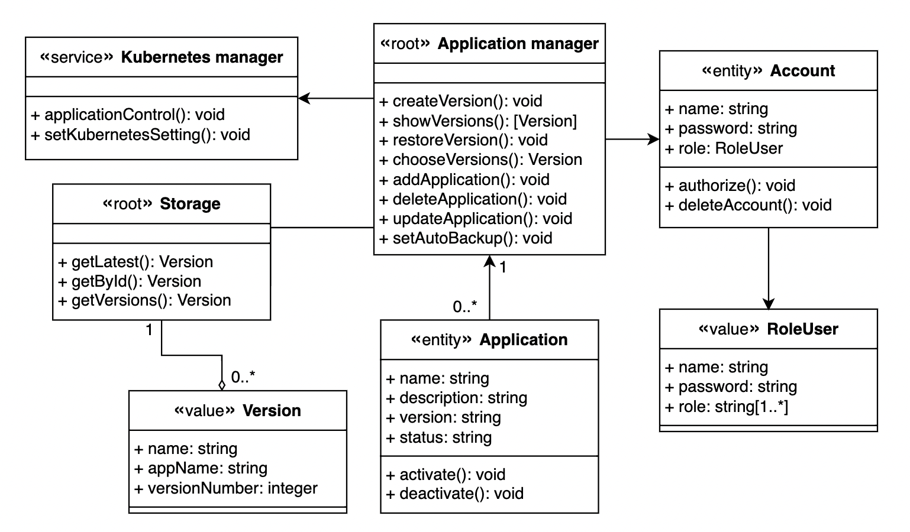
Domain model diagram

